Slide 1
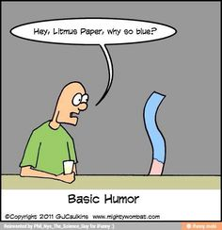

Slide 2
A2 Chemistry
Acids and Bases

Slide 3
Review
Write an ionised equation and observation for the reaction between a solution of copper II chloride and a solution of sodium carbonate. (4 marks)

Slide 4
Learning Intentions
indicator colour and the pH scale are used to classify aqueous solutions as acidic, basic or neutral
the Arrhenius model can be used to explain the behaviour of strong and weak acids and bases in aqueous solutions

Slide 5
Success criteria
Classify solutions as acidic, basic or neutral based on their pH or colour in indicators (such as universal indicator or litmus).
Classify acids and bases as strong or weak.
Summarise Arrhenius model.

Slide 6
Properties
Acids:
sour
corrosive
pH below 7
usually contain H
eg HCl
Bases:
bitter
corrosive
pH above 7
usually contain OH
eg NaOH

Slide 7
Key words
Strength
Concentration
Electrolyte

Slide 8
The Arrhenius Model
Arrhenius describes acids and bases in terms of what they contain
ie acids contain H
bases contain OH
This doesn’t cover all acids and bases: there are other models which deal with these.

Slide 9
Strength
Is different to concentration!
(Use words like concentrated or dilute instead)
Strength of any electrolyte is the degree to which it ionises or dissociates to produce ions in solution.
What is an electrolyte?

Slide 10
Strong acids
HCl
H⁺ + Cl⁻
100% ionisation
hydrochloric acid HCl
sulfuric acid H₂SO₄
nitric acid HNO₃

Slide 11
Strong bases
NaOH
Na⁺ + OH⁻
100% dissociation
sodium hydroxide NaOH
potassium hydroxide KOH
Lithium hydroxide LiOH
(Hydroxide of any group 1 metal)

Slide 12
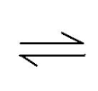
Weak acids
CH₃COO⁻ + H⁺
CH₃COOH
only partial ionisation

Slide 13
Weak bases
NH4⁺ +OH⁻
NH3
+H2O
NH4OH _{(aq)}
only partial dissociation

Slide 14
Success criteria
Classify solutions as acidic, basic or neutral based on their pH or colour in indicators (such as universal indicator or litmus).
Classify acids and bases as strong or weak.
Summarise Arrhenius model.

